Slide 1
ENGI 301 <Golf Ball Dispenser> Proposal
<10/19/19>
<Luis Perales>

Slide 2
Background Information
I am proposing a dispenser of golf balls that would work perfectly for a small putting green I already have (I’m a huge golf fan)
Essentially, I want to make a box (small enough that it doesn’t make too much space) that dispenses golf balls through a small hole at the bottom with a ramp that dispenses the ball where my putter is. The way this would happen is I will just wave my club in front of a box, and one ball will be dispensed, along with a little jingle that will give you good luck on the shot.
https://www.hackster.io/GordPayne/arduino-ping-pong-ball-cannon-3c1fdd
Link to a project for a ping pong ball cannon in which a motor pushes a ball into the cannon. This same idea can be used for my project as I need something to push down a wedge so a ball can be dispensed after a certain action (pushing button or waving putter-head in front of device)

Slide 3
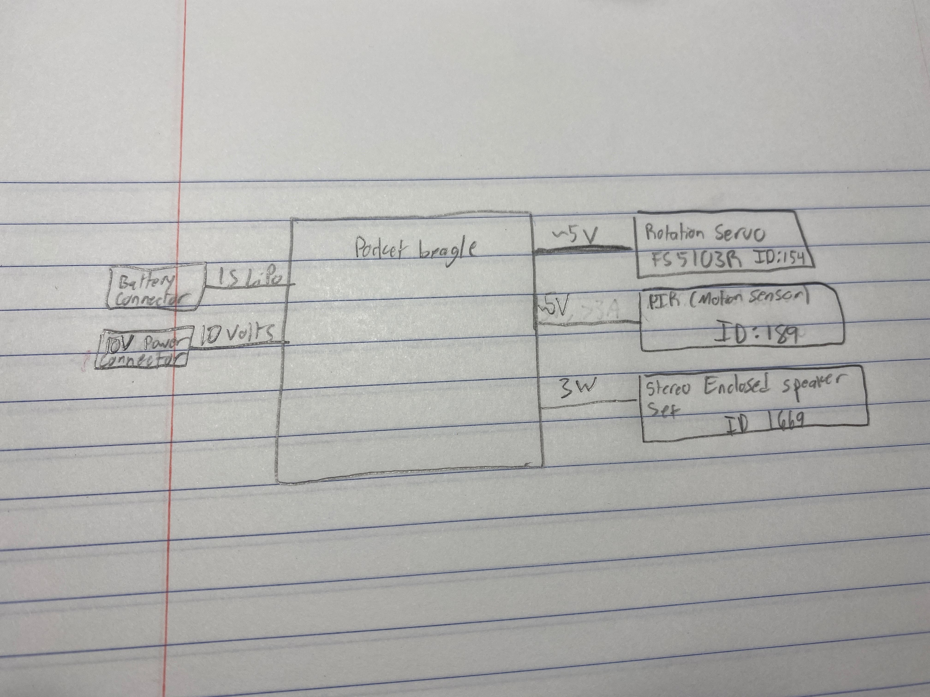
System Block Diagram

Slide 4
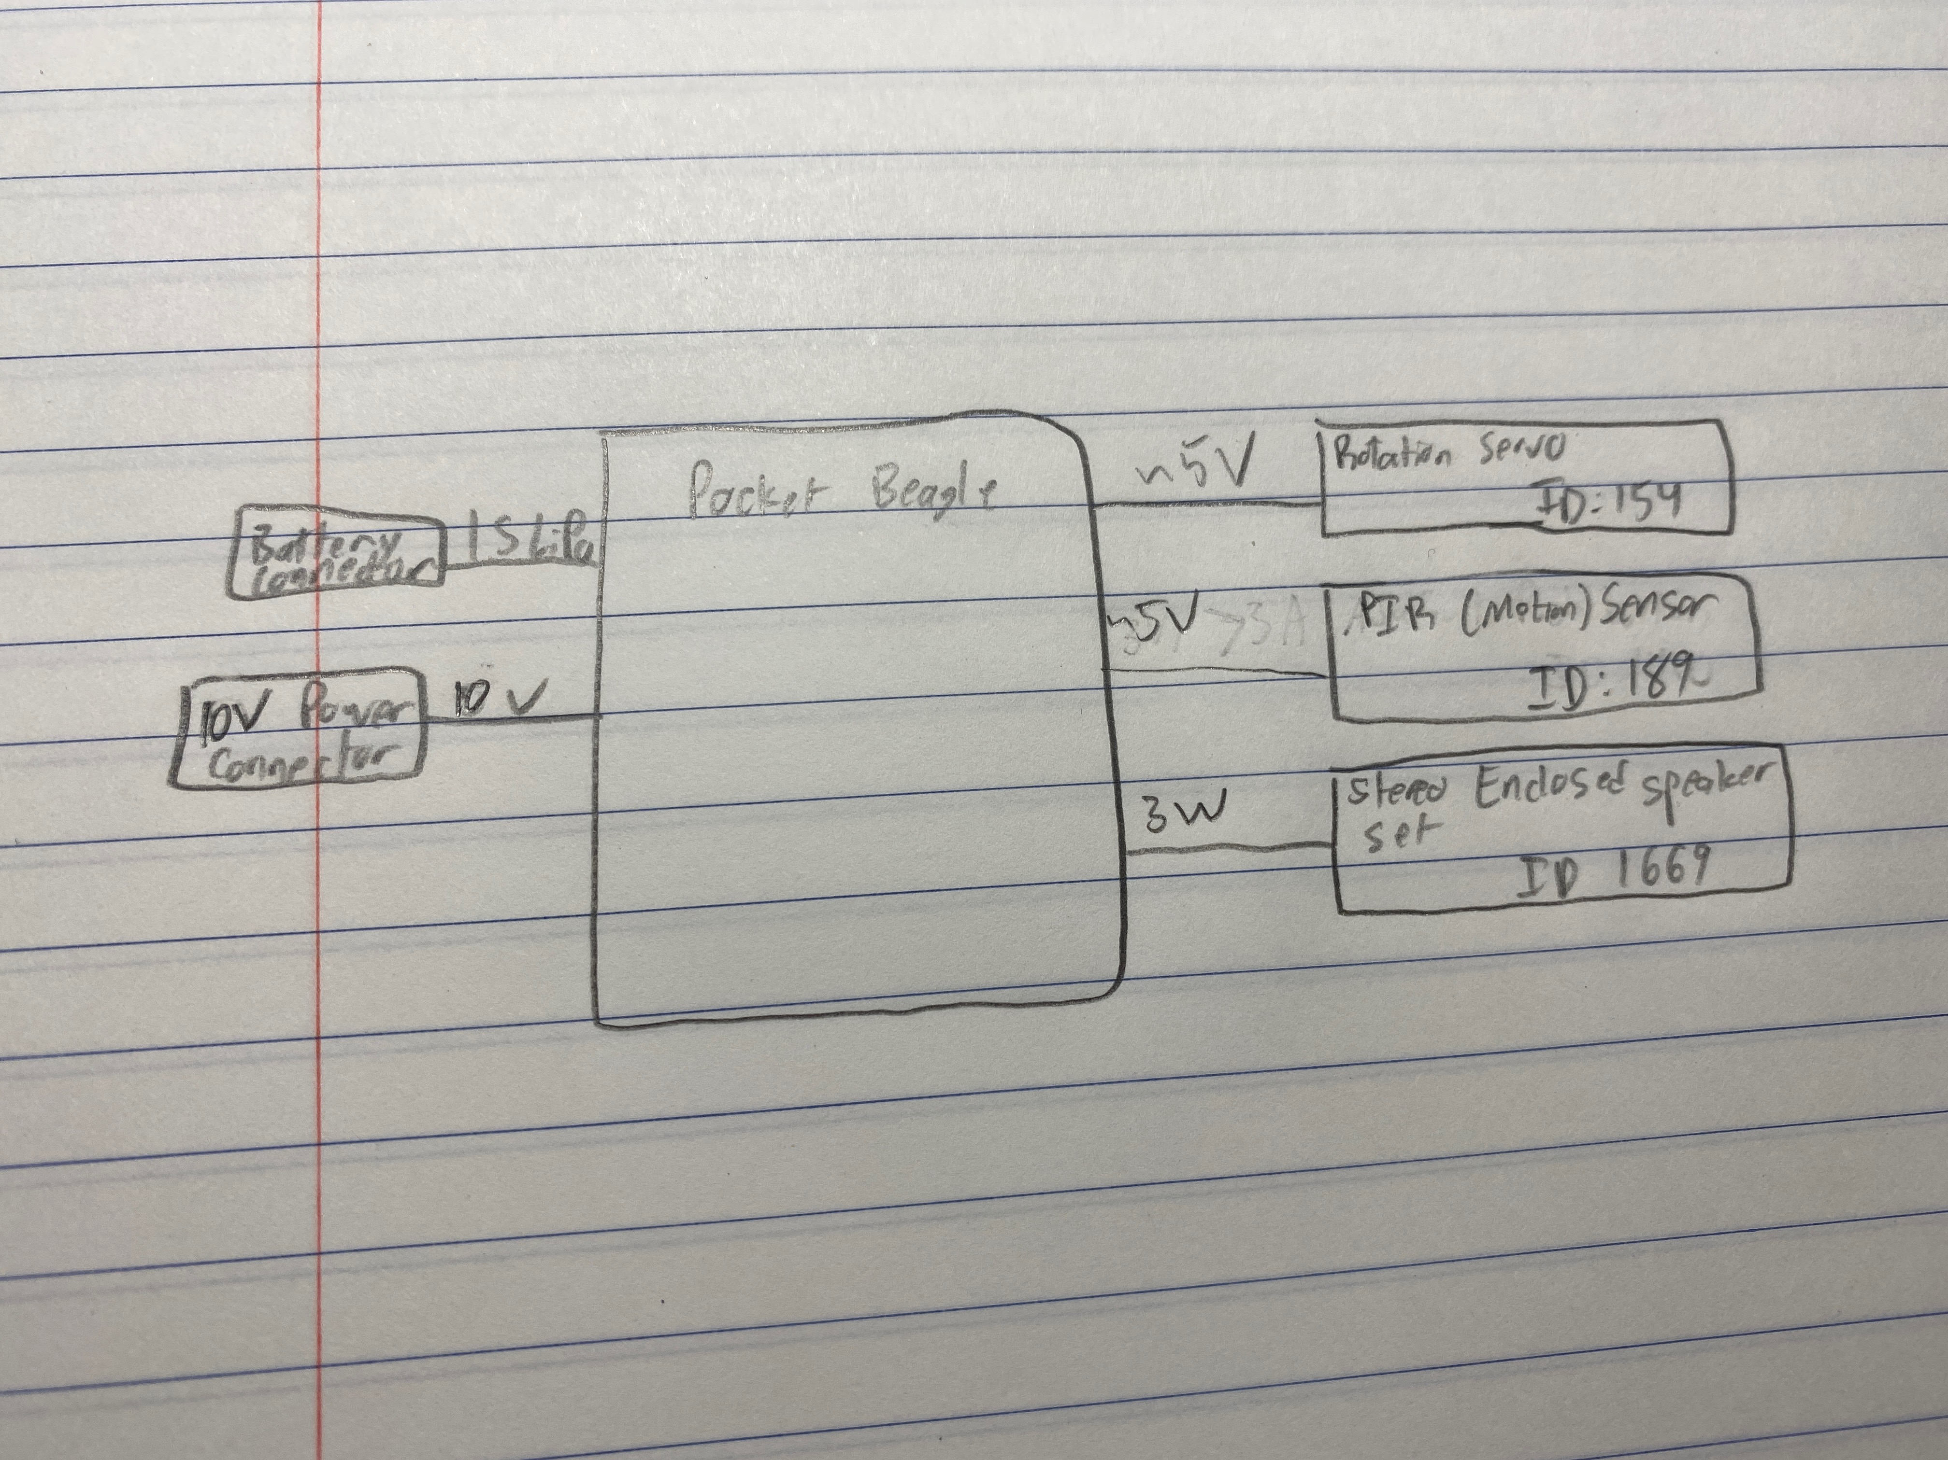
Power Block Diagram

Slide 5
Components / Budget
Component | Need to Buy | Cost
Ply-wood | Possibly?
Continuous Rotation Servo - FeeTech FS5103R | Yes | 11.95
PIR (motion) sensor | Yes | 9.95
breadboard | no
Wiring | no
Cardboard or Styrofoam to make the button a little bigger for my putter | no
Stereo Enclosed Speaker Set | Yes | 7.50

